Slide 1
Introduction to graphs
Learn to solve problems using graphs

Slide 2
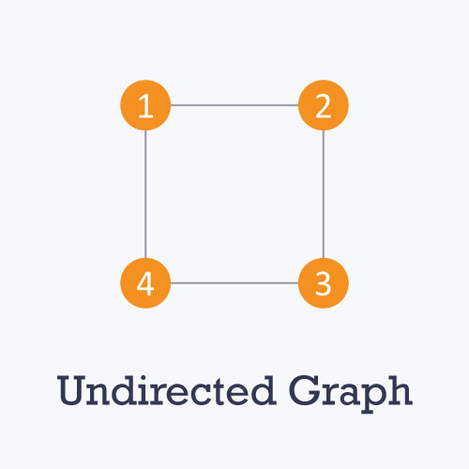
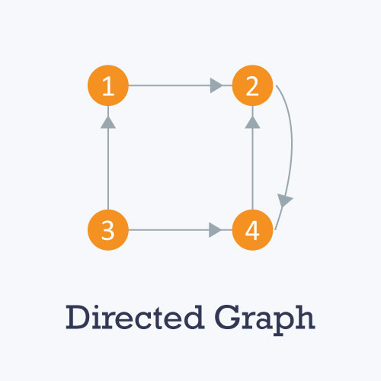
Introductions
A Graph is a structure amounting to a set of objects in which some pairs of the objects are in some sense related. These objects correspond to mathematical abstractions called vertices. The related pairs are called edges. The graph is represented as a set of vertices and edges.
Nodes are entities whose relationships are expressed using edges.
If a graph comprises 2 nodes A and B and an undirected edge between them, then it expresses a bi-directional relationship between the nodes and edge.
Edges are the components that are used to represent the relationships between various nodes in a graph. An edge between two nodes expresses a one-way or two-way relationship between the nodes.

Slide 3
Terminologies
Types of nodes
Root node: The root node is the ancestor of all other nodes in a graph. It does not have any ancestor. Each graph consists of exactly one root node. Generally, you must start traversing a graph from the root node.
Leaf nodes: In a graph, leaf nodes represent the nodes that do not have any successors. These nodes only have ancestor nodes. They can have any number of incoming edges but they will not have any outgoing edges.
Loops are defined as self-edges or an edge which is of the form (a, a) where a is a node in the graph.
Parallel Edges are edges of the same type with the same end-vertices.
Degree of a vertex is defined as the number of incident edges.
In-Degree is the number of incoming edges. It is defined only for a digraph.
Out-Degree is the number of outgoing edges. It is defined only for a digraph.
Simple Graphs are defined as the class of graphs that do not have loops or any parallel edges.
Path is defined as a sequence of vertices such that every consecutive pair of vertices is connected by an edge.

Slide 4
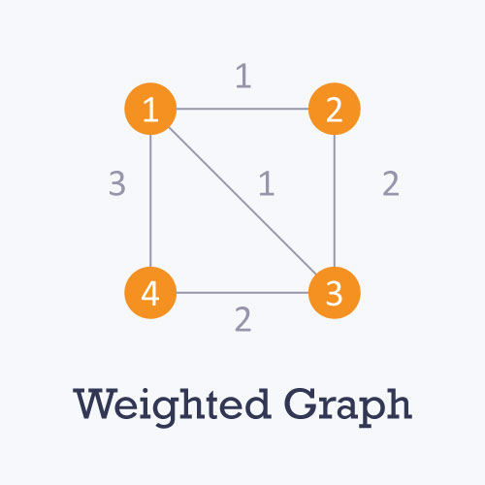
terminologies
Cycle is a path that starts and ends at the same vertex.
Simple Path is a path with distinct vertices.
Directed Path is a path of directed edges.
Directed Cycle is a cycle of directed edges
Sub Graph is a subset of vertices and Edges.
Spanning Sub Graph is a sub-graph that contains all vertices.
Connected Graph is a graph that has all the pairs of vertices connected, i.e, a path exists between any two nodes in the graph.
Connected Component is the maximally connected sub-graph of an unconnected graph.
Forest is a graph without cycles.
Tree is a connected forest.
Spanning Tree is spanning sub-graph that is also a tree.

Slide 5
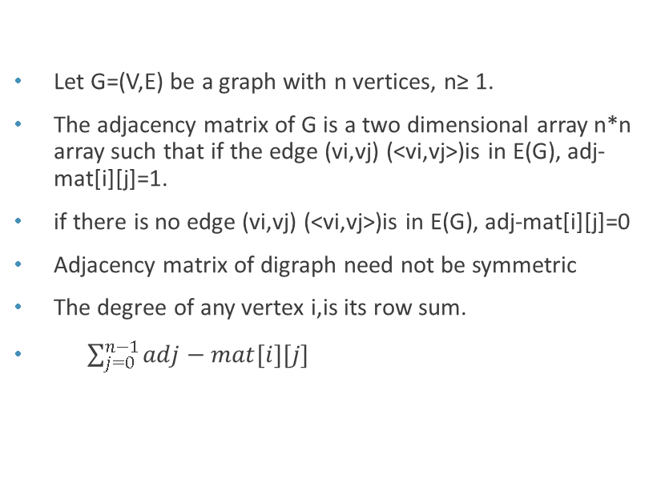
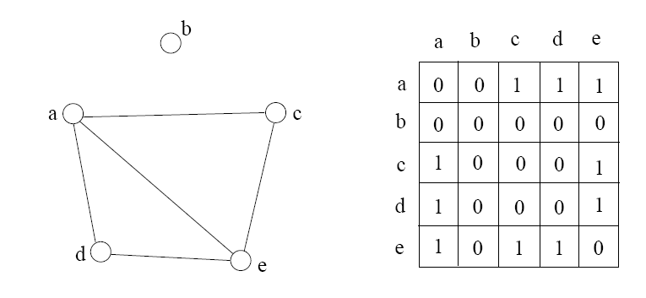
Graph representation – Adjacency matrix
Let G=(V,E) be a graph with n vertices, n≥ 1.
The adjacency matrix of G is a two dimensional array n*n array such that if the edge (vi,vj) (<vi,vj>)is in E(G), adj-mat[i][j]=1.
if there is no edge (vi,vj) (<vi,vj>)is in E(G), adj-mat[i][j]=0
Adjacency matrix of digraph need not be symmetric
The degree of any vertex i,is its row sum.
$\sum_{j=0}^{n−1}{adj−mat[i][j]}$

Slide 6
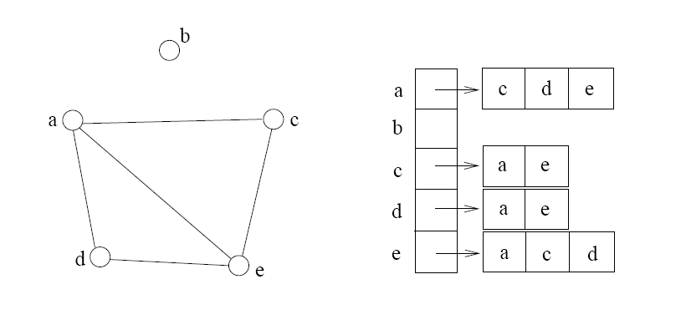
Graph representation – adjacency list
An Adjacency list is a collection of unordered lists with each list containing the neighbors of the corresponding vertex
Technically, the adjacency list is an array A[0..n-1] of lists, where n is the number of vertices in the graph. Each array entry is indexed by the vertex id (as with adjacency matrix)‏
The list A[i] stores the ids of the vertices adjacent to i.

Slide 7
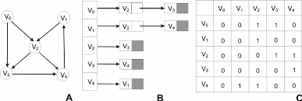
Adjacency matrix vs adjacency list
Adjacency Lists
More compact than adjacency matrices if graph has few edges
Requires more time to find if an edge exists
Adjacency Matrix
Always require n² space
This can waste a lot of space if the number of edges are sparse
Can quickly find if an edge exists

Slide 8
Depth first search
In this method, After visiting a vertex v, which is adjacent to w1, w2, w3, ...; Next we visit one of v's adjacent vertices, w1 say. Next, we visit all vertices adjacent to w1 before coming back to w2, etc.
Must keep track of vertices already visited to avoid cycles.

Slide 9
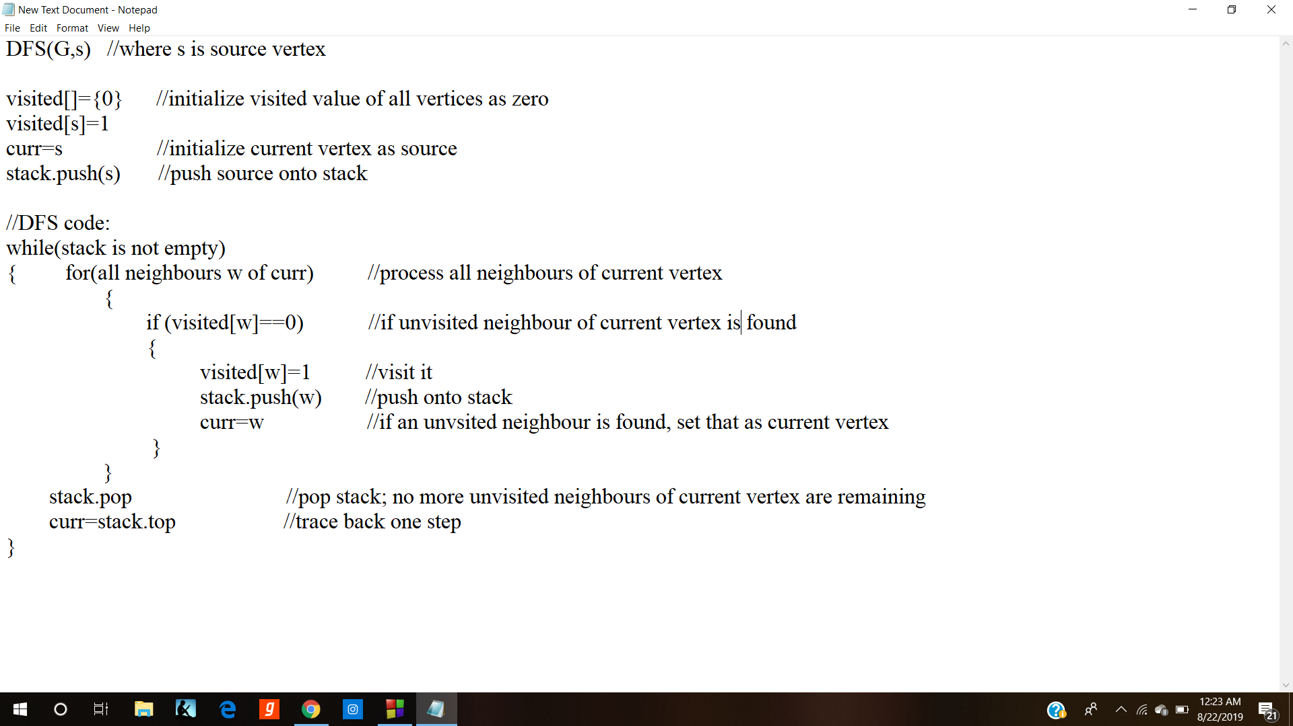

Slide 10
Breadth first search
In this method, After visiting a vertex v, we must visit all its adjacent vertices w1, w2, w3, ..., before going down next level to visit vertices adjacent to w1 etc.
The method can be implemented using a queue.
A boolean array is used to ensure that a vertex is enqueued only once.

Slide 11
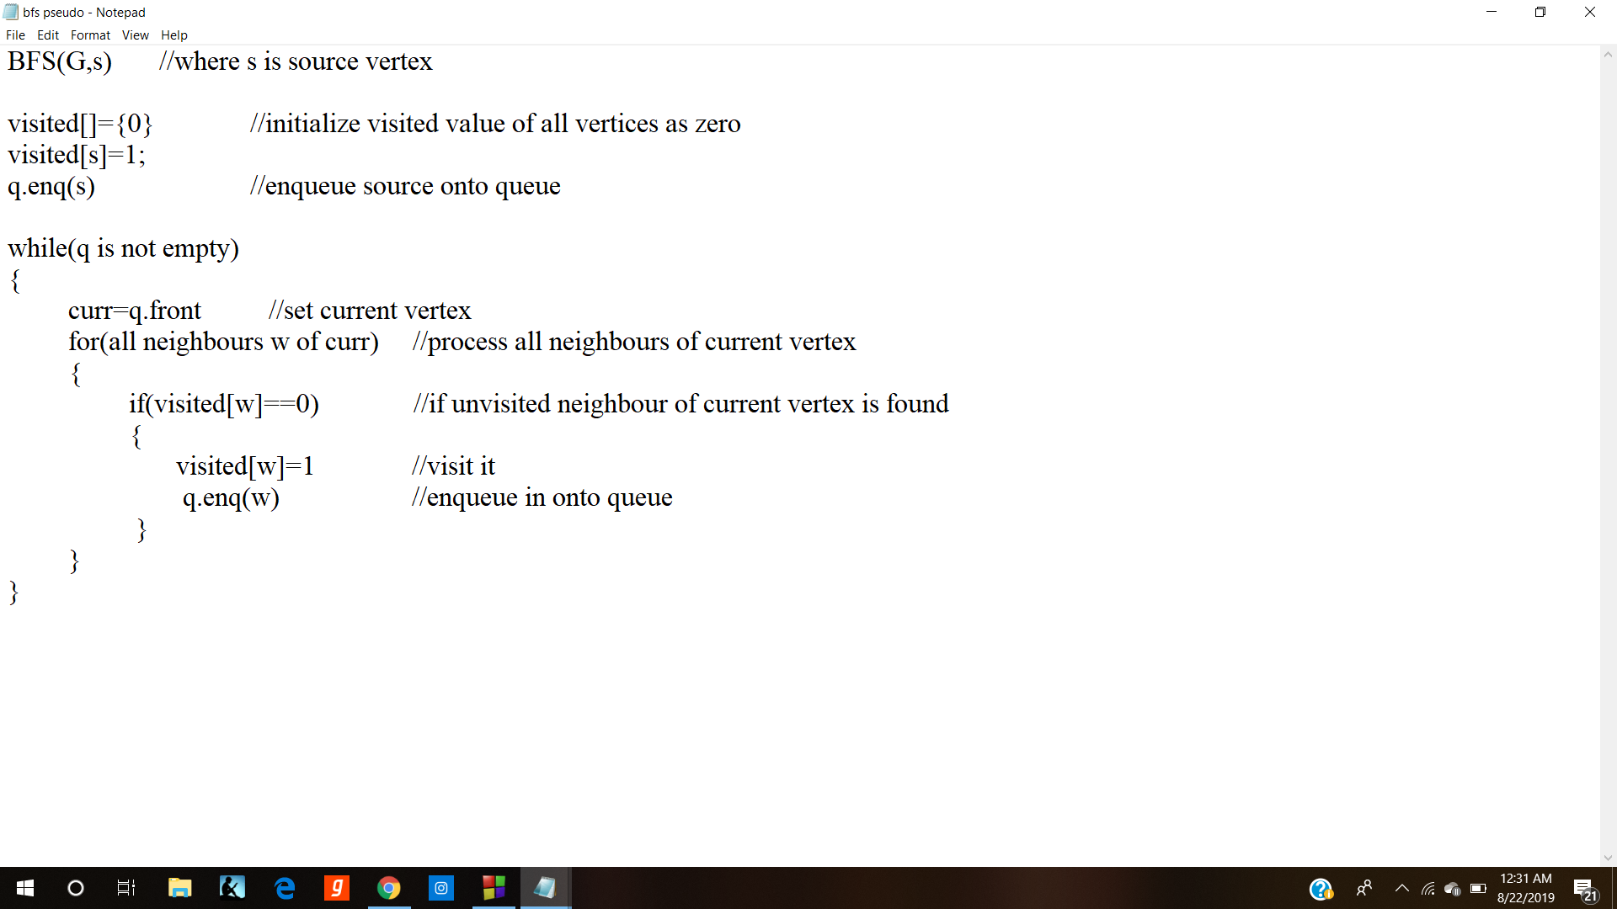

Slide 12
Shortest path algorithm
For non-weighted graphs, we can just use the Breadth-First Search algorithm with a helper “visited” array to track the shortest distances.
For weighted graphs, we can make use of the Dijkstra’s algorithm.
Let the source node be named the root. Let the distance of the node Y be the distance from the root to the node Y. The algorithm advances as follows,
Mark all the nodes as unvisited. Create a set of vertices with all the vertices as unvisited set.
Initialize the distance values for every node to infinity except for the root node which is set to zero.
For the current node, consider all it's neighbors and change the values of the distance to the minimum between the current value and the distance through the current node. For example, if the current node A is marked with a distance of 6, and the edge connecting it with a neighbor B has length 2, then the distance to B through A will be 6 + 2 = 8. If B was previously marked with a distance greater than 8 then change it to 8. Otherwise, keep the current value.
When the iteration is completed, mark this current node as visited and remove it from the unvisited set. This ensures that a visited node will never be visited again.
Move to the next node in the unvisited set with minimum distance value and repeat the above steps for this node.
If the node selected is already visited or if all the unvisited nodes have the distance value as infinity, then stop.

Slide 13
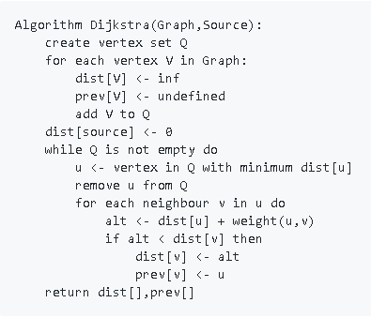
Dijkstra’s algorithm
The time complexity of this algorithm is
O(E + V log V).

Slide 14
PROBLEMS

